Slide 1
The importance of sleep
Lesson 3
Improving my sleep
Version 1 2023
Notes:
Improving my sleep is the third lesson of a 3-lesson teaching module called The importance of sleep.

Slide 2
Lesson introduction
Learning goals
Wellbeing indicators
By the end of the lesson, we will:
Better understand our sleep routine and sleep hygiene
Be able to identify how my sleep can be improved
Be aware of new relaxation techniques
Notes:
Outline of the learning goals.

Slide 3
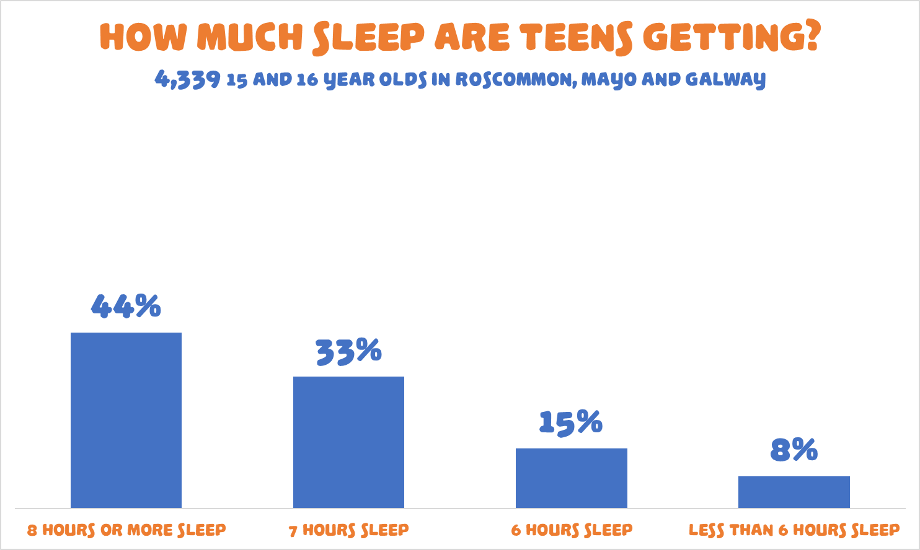
Notes:
This slide is just a quick reminder for the pupils of how many of our teens are sleeping poorly.
All results and statistics are from the November 2022 Planet Youth survey of 4,339 15 and 16 year-old teenagers in the 81 post-primary schools and 10 Youthreach centres in Galway, Mayo and Roscommon. Full reports from the survey are available for download from the www.planetyouth.ie website.

Slide 4
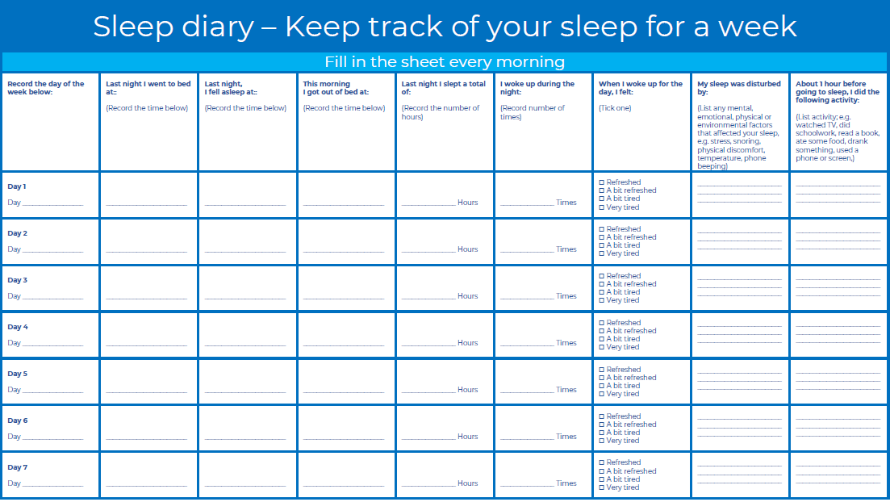
Sleep diary worksheet
Notes:
This is the Sleep Diary worksheet. It was assigned as homework at the end of lesson 2 and, together with the Sleep Questionnaire worksheet, it should give pupils some insights into their sleep routines, behaviours, and deficits.
There can be a general teacher-led discussion on the worksheet. “We know from the bar chart that over half of teenagers aren’t getting enough sleep, and this sleep diary exercise should have been useful to help you see how you’re getting on for your sleep.”
“Did anyone see anything interesting when filling in the worksheet? “ “Was there anything that surprised you? “ “The rest of this lesson is going to be about ways we can improve our sleep and we’re going to start with a short video.”

Slide 5
Lesson introduction
Improving sleep – short video
Notes:
Introductory video for Lesson 3 of the The Importance of Sleep teaching module. This short 1’33” video is intended to get the discussion going in the classroom about things we could be doing to improve our sleep. Click on the image to link to the video, which is hosted on the Planet Youth SPHE website called The Facts.
This video was developed with the support of the students and staff in Castlerea Community School and all the information and statistics in the video are from the November 2022 Planet Youth Survey of 4,339 15 and 16 year-old pupils in the 91 post-primary schools and centres in Galway, Mayo and Roscommon.

Slide 6
Discussion
So, what do we think of the video, can we do things to improve our sleep?
Are there more ways than the ones mentioned in the video?
Notes:
Teacher led classroom discussion.
So, what do we think of the video, can we improve our sleep?
Are there more ways than the ones mentioned in the video?

Slide 7
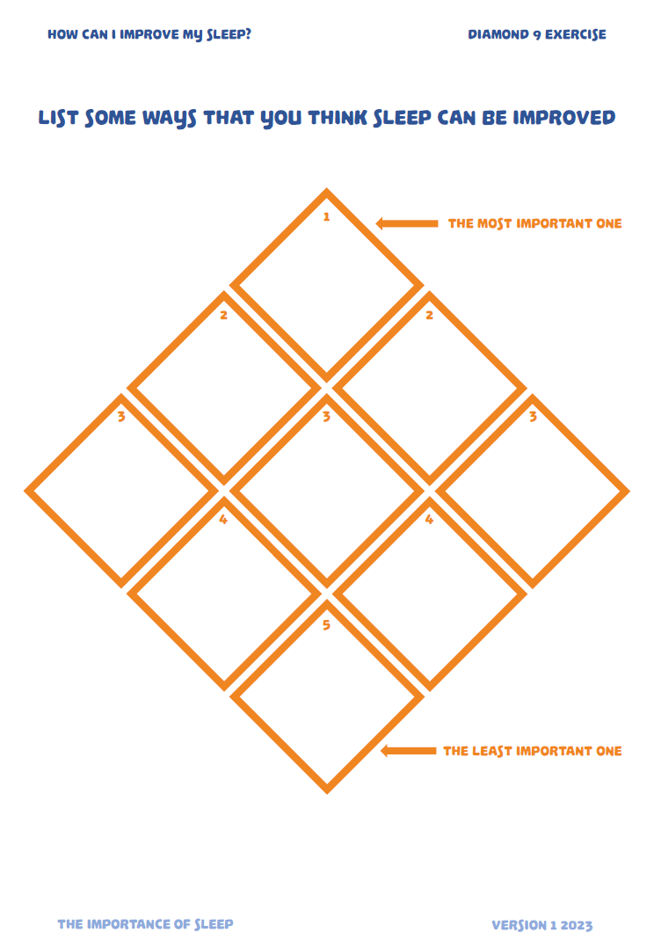
Diamond 9 group exercise
Ways to improve our sleep
Come up with some ideas about ways that sleep can be improved
Try to come up with nine
Put your most important at the top and your least important at the bottom
Notes:
Optional Diamond 9 class exercise. Can be completed individually or in groups and the exercise can then be discussed. There’s a lot to get through in the class so it may be worth moving along here. The pupils are unlikely to come up with an exhaustive list and the next few slides go into a bit more detail on ways that sleep can be improved.

Slide 8
Sleep Hygiene
What is sleep hygiene?
The term sleep hygiene really refers to having good habits and behaviours related to your sleep routine.
Having good sleep hygiene should lead to you having an easier time falling asleep and having longer and better-quality sleep throughout the night.

Slide 9
Healthy Sleep Hygiene Guidelines
Prioritise your sleep and dedicate enough time for it.
Go to bed and wake up at the same times each day.
Create a dark, cool, and quiet bedroom environment.
Avoid bright lights or screens, especially around bedtime.
Ideally, keep screens out of the bedroom altogether, particularly after lights out.
Have a regular bedtime routine that includes relaxing activities.
Don’t have tea, coffee, or energy drinks late in the day, and avoid heavy meals close to bedtime.
Try to get some exercise every day.
Expose yourself to natural sunlight early in the day, ideally before 10am.
Don’t have any naps after 3pm.
Notes:
All the information below, and that in the slide, is contained in the Sleep Plan Handout that you can print out for the students to take home.
You can do a lot of things to improve your sleep.
Prioritise your sleep and dedicate enough time for it. Make time for sleep. Pick a bedtime that allows you to get the recommended amount of sleep for your age. Teens should be getting at least 8 hours of sleep.
Go to bed and wake up at the same times each day. Being consistent can make a big difference to how much and how well you sleep. Set and keep to a sleep schedule. Go to bed and wake up at the same time every day. This does mean including weekends, if at all possible. At least avoid the temptation for giant lie-ins. Staying up very late at weekends and having big lie-ins will throw out your routine and make the next school week harder. If you really struggle with this, consider finding an activity that you have to get up early for at the weekend.
Create a dark, cool, comfortable, and quiet bedroom environment. Try to make your bedroom like a dark cave. Eliminate all the light you possibly can, including the LEDs on chargers and decorative lights or fairy lights. Make sure you have a mattress and pillow that suit you, and change your bedding regularly. Make your bed a cosy, appealing place. Try to organise blackout curtains or shades.
Avoid bright lights or screens, especially around bedtime. It’s a good idea not to use bright overhead lights at nighttime. If possible, use side lights, table lamps or reading lamps that have softer or warmer bulbs. Try to dim even these lights an hour before bed and avoid screen use if you can. At the very least, sure you have a blue light filter on your phone and turns the screen brightness down. More so than any other light, blue light messes with your body’s ability to prepare for sleep because it suppresses the production of melatonin, the hormone that promotes feelings of sleepiness.
Ideally, keep screens out of the bedroom altogether, but particularly after lights out. There are plenty of reasons to keep screens and phones out of your bedroom. It makes it easier to avoid their use when you should be transitioning to sleep. It also prevents checking your phone should you wake during the night. If you wake and use your phone, it will be far more difficult to fall back asleep. Also, phones are designed to get your attention. If you forget to put your phone in do-not-disturb mode, then messages, notifications, or updates are going to wake you. Phones are addictive of course, so if the idea of leaving it out of the bedroom causes you any anxiety, then all the more reason to do so. Make sure that you’re in control of your phone and that it’s not in control of you.
Have a regular bedtime routine that includes relaxing activities. This is really important. More on this in later slides.
Don’t have tea, coffee, or energy drinks late in the day, and avoid heavy meals close to bedtime. What you consume in the evening can affect your sleep. Cut back on caffeine from coffee, tea, or energy drinks, especially late in the day. Avoiding large meals before bed may also help to improve your sleep.
Try to get some exercise every day. Exercising each day provides a lot of benefits and will improve your sleep. Try for at least 30 minutes of physical activity each day. Avoid heavy exercising close to bedtime though, as this will make it hard for your body and brain to wind down.
Expose yourself to natural sunlight early in the day, ideally before 10am. Getting natural light early in the day helps make sure your internal clock is keeping good time and will help you to sleep better at night.
Don’t have any naps after 3pm. A well-timed nap can help you feel more alert during the day and make up for lost sleep, but napping too late in the afternoon will make it difficult to fall asleep when bedtime rolls around. Experts recommend keeping naps to around 20 minutes and avoiding naps after around 3pm.

Slide 10
Other things to think about
Managing your stress. Stress is a normal reaction to difficult experiences but high levels of stress, or stress left unaddressed it can significantly interfere with your sleep. Finding ways to manage your stress will make it easier for you to sleep at night. Managing your time. Effective use of your time will free up the opportunity to get loads more sleep. Good time management skills can be learnt and are an asset in most areas of your life.

Slide 11
Good Routines
Routines really do matter.
Research shows that people who follow bedtime routines are more likely to go to sleep earlier, take less time falling asleep, sleep longer, and wake up less during the night. A consistent routine also helps train your brain that it’s time to get ready for bed.
Routines are different for everyone, so decide on your own, just remember that good sleep routines start well before lights-out. In fact, we can have wind-down routines, bedtime routines, and morning routines that will each help us get more sleep.

Slide 12
Example of a wind-down routine
Starts 60 minutes before bedtime.
Turn off the overhead lights in the house or in your room, turn on lamps instead.
Have a last check-in on your phone and put it on charge in the kitchen or hallway.
Get your bag sorted for the morning.
Take a shower or bath.
Make a bowl of cereal.
Do some nighttime skin care.
Check in with the family or watch an episode of TV with them.
Listen to some relaxing music.

Slide 13
Example of a bedtime routine
Starts 15-30 minutes before bedtime.
Brush your teeth
Change into pj’s
Write in a journal
Set your manual alarm clock
Read a book in bed (sleep-friendly book light, not a ceiling light)
Listen to a calming podcast, audio book or meditation. (you can set a timer)
Lights out (get rid of every single bit of light from your room you possibly can)

Slide 14
Sleeping problems
If…
You’re having trouble falling or staying asleep at least three nights per week
You regularly wake up feeling unrested
Your daytime activities are affected by tiredness or poor mental alertness
You often need to take a nap to get through the day
Lack of sleep is affecting your physical or mental wellbeing
…then you really need to take action to prioritise your sleep more. If the problem then persists, in spite of your efforts, be sure to talk to a parent or trusted adult about it, and together you can decide on next steps.

Slide 15
Relaxing and meditating
Some ways to relax and de-stress before bed or in bed
Guided and imagery meditation
Breathing techniques
Body-scan meditation
Mindfulness meditation
Journalling – write down your thoughts or worries
Notes:
Address that stress. Practicing meditation is proven to reduce anxiety, improve sleep quality and even help with insomnia. Meditation puts you in the perfect mindset to drift off to sleep. There are many videos available online or in apps to help you and also some written guides. On the topic of writing, journaling is another great way to quiet your mind by getting your thoughts and feelings down on paper. Get yourself a journal to write in and avoid all the distractions of your phone or computer. There are lots of great websites, apps, and podcasts where you can find great meditations for teens and sleep. Look for Guided and imagery meditation, Breathing techniques, body-scan meditation, mindfulness meditation, meditation for sleep. www.mindfulnessforteens.com and mindfulnessexercises.com might be good places to start. If there’s an appetite within the group, you could devote a class or two to practicing some mindfulness and mediation for sleep exercises.

Slide 16
Sleep Plan Handout
Notes:
We could all do with improving our sleep and, whether it’s by a little or by a lot, having a Sleep Plan will help us achieve our goals. The Sleep Plan handout has a lot of the information we went through today in it and will give you some good ideas about coming up with some simple steps to help you improve your sleep.
A Sleep Plan can look like:
Identifying a time that you’d like to be asleep by
Communicating with your family about your sleep goals
Taking steps towards creating a better sleep environment
A good sleep plan helps you enjoy the idea of going to bed and two tips to consider when creating a sleep plan are:
Make your own routine. Creating a nighttime routine will train your body and brain to know when it’s time to prepare for sleep.
Eliminate distractions. Distractions can be anything that interferes with your ability to wind down. Anything that keeps you awake instead of aiding your sleep. They might include screen time right before bed, doing too much homework or exercise late, or not getting rid of your phone from the bedroom. If something is engaging your thoughts when you should be asleep, it’s probably a distraction.

Slide 17
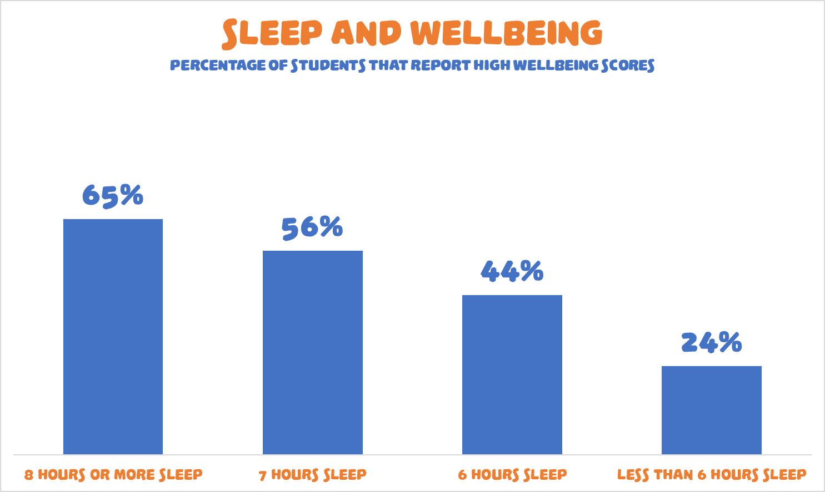
Notes:
One last reminder of why we would make a Sleep Plan and how important sleep is for our wellbeing.
This slide was used in Lesson 1 and shows the percentage of pupils that had high wellbeing scores, correlated against their amount of sleep per night. The scores are derived from the Short Warwick-Edinburgh Mental Wellbeing Scale (SWEMWBS). This is a seven-question validated scale within the Planet Youth questionnaire..
All statistics are from the November 2022 Planet Youth Survey of 4,339 15 and 16 year-old pupils in the 91 post-primary schools and centres in Galway, Mayo and Roscommon.

Slide 18
A quote to finish on
“The thing I prioritise above everything else is sleep” “It's the best way for your body to physically and emotionally recover and get back to 100%”
LeBron James

Slide 19
Lesson review and 3-2-1 exercise
Learning Goals
3-2-1
At the end of the lesson, I now:
Better understand my sleep routine and sleep hygiene
Am able to identify how my sleep can be improved
Am aware of new relaxation techniques
Three things I learned today.
Two Things I found interesting?
One question I still have?
Notes:
Optional. This slide is the review of learning goals and there is also a 3-2-1 worksheet exercise.
Students are invited to reflect on:
Three things I learned today.
Two things I found interesting.
One question I still have.
Quick Rating
Even if there is only one or two minutes left in the lesson, there may still time for a quick lesson review. Ask the students to use their fingers to give the lesson a rating out of five, then ask three students to share the reason for their rating with the class. The rating might be a general rating on the overall lesson, or it may be more specific, such as asking the students to give a rating of how well they understood the concept or a rating of personal improvements.

