Slide 1
The importance of sleep
Lesson 2
My relationship with sleep
Version 1 2023
Notes:
My relationship with sleep is the second lesson of a 3-lesson teaching module called The importance of sleep.

Slide 2
Lesson introduction
Learning goals
Wellbeing indicators
By the end of the lesson, we will:
Better understand the science of sleep
Be able to identify some common sleep problems
Better understand our own relationship with sleep.
Be ready to practice personal sleep analysis
Notes:
Outline of the learning goals.

Slide 3
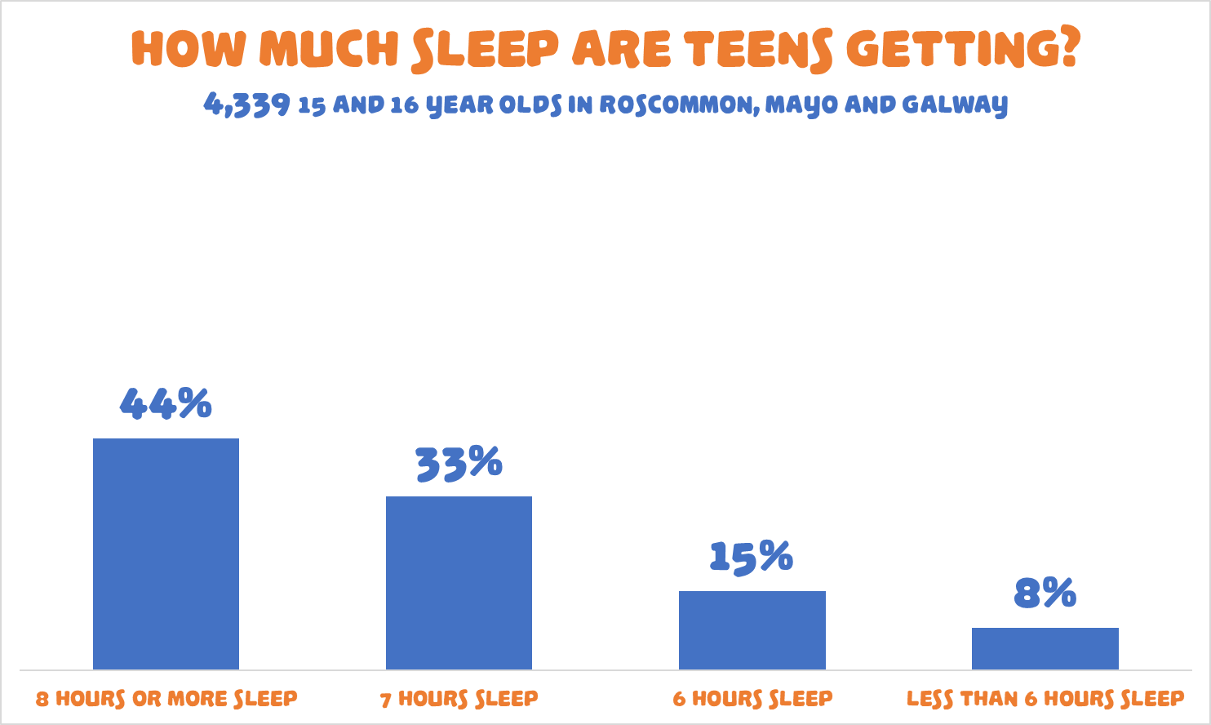
Notes:
This slide is just a quick reminder for the pupils of how many of our teens are sleeping poorly.
All results and statistics are from the November 2022 Planet Youth survey of 4,339 15 and 16 year-old teenagers in the 81 post-primary schools and 10 Youthreach centres in Galway, Mayo and Roscommon. Full reports from the survey are available for download from the www.planetyouth.ie website.

Slide 4
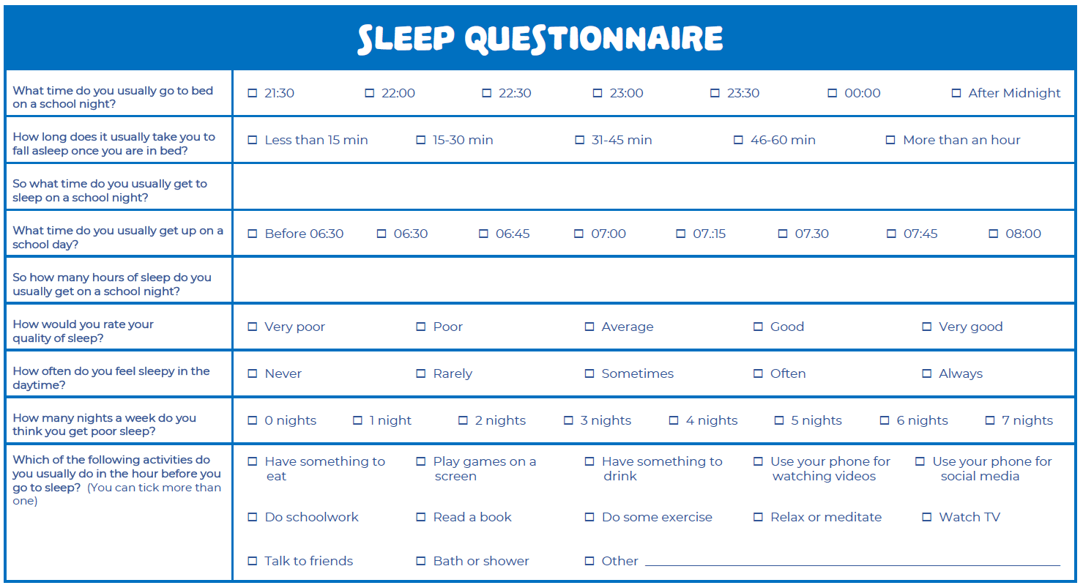
Sleep questionnaire worksheet
Notes:
This is the sleep questionnaire worksheet. It may have been assigned as homework at the end of lesson 1, or the pupils can take a few minutes to complete it now. There can be a general teacher-led discussion on the worksheet. “We know from the slide and from the last lesson that over half of teenagers aren’t getting enough sleep, so this exercise should be useful to help us see how much sleep we’re getting individually.”
Did anyone spot anything interesting when filling in the worksheet? Was there anything that surprised you? Who rated their sleep as average? Or good? Or poor? Did anybody put very good or very poor? “We might come back to this questionnaire later, but let’s move on for now and look a bit at how and why we sleep.”

Slide 5
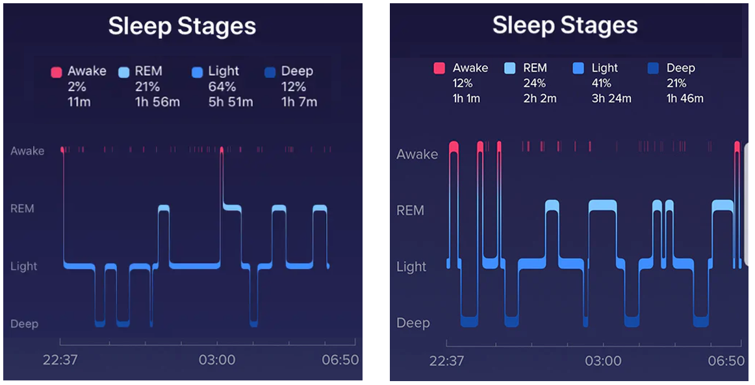
Sleep tracker images – Discussion
Notes:
Teacher-led discussion. This is a brief discussion with the class about the sleep tracker images. Ask the class who had the better sleep. Is it the person who had the sleep stages on the left? Or the person on the right? Why? Just take a couple of minutes to get some idea of what the pupils think, we revisit this slide later in the class.
“Well let’s have a look at the science of what’s actually happening while we sleep.”

Slide 6
The science of sleep
The two processes that regulate sleep
The homeostatic sleep drive
This is the body’s self-regulating system in which pressure to sleep builds up based on how long you’ve been awake. This same drive causes you to sleep longer or more deeply after a period of insufficient sleep.
The circadian rhythm and internal clock
These control your timing of sleep and cause you to be sleepy at night and to wake in the morning. Your body’s internal or biological clock, which is based on a roughly 24-hour day, controls most circadian rhythms. These include sleep and wake times but also things such as brain activity, the release of hormones, body temperature and appetite. Daylight exposure is the biggest influence on circadian rhythms.
Notes:
The two processes that regulate sleep
Falling asleep and staying asleep, are both rooted in our biology. Just like language or motor skills, sleep matures over the first years of our lives. The onset of puberty is linked with changes to how we experience our sleep. As we grow, two main processes begin to regulate sleep. The homeostatic sleep drive and the circadian system.
The homeostatic sleep drive is the body’s self-regulating system in which pressure to sleep builds up based on how long we’ve been awake. This same drive causes you to sleep longer or more deeply after a period of insufficient sleep.
The circadian rhythm and internal clock
The other system regulating sleep begins with a powerful internal clock nestled in the brain. This clock is a biological pacemaker that controls the circadian rhythm allowing us to initiate the light and dark pattern of day and night. The internal clock sends messages through the 24-hour day influencing our wake patterns and many other biological processes. As bedtime approaches, our temperature begins to go down, and levels of the sleep-inducing chemical melatonin rises in preparation for sleep. Toward morning time, levels of the hormone cortisol rise alerting the body to awaken.
Theoretically, the alignment of these two processes predicts maintenance of wakefulness and alertness during the daytime and maintenance of sleep at night. The ideal balance between systems is challenged during adolescence as both processes show development changes and behavioural demands and choices further alter the balance.
Developmental changes and psychosocial influences on sleep in adolescence
Sleep-wake behaviour changes across adolescence are the product of changing regulatory sleep mechanisms and evolving psychosocial factors. A hallmark behavioural change is bedtime getting later - the onset of puberty has been linked to this.
Parent-set bedtimes also become less common, staying up later to study, to train, spend time on devices for example contribute to later bedtimes.

Slide 7
The science of sleep
The stages of sleep
NREM Sleep – Non Rapid Eye Movement
Stage 1 - Eyes closed on the threshold between awake and asleep. You can be easily awakened Stage 2 - This is light sleep; your heart rate begins to slow and body tempearture goes down. Stage 3 - Slow wave sleep, now you are in deep sleep. Blood pressure and heart rate go down, and your breathing slows. It is harder to wake you up. A lot of deep sleep happens in the first part of the night.
REM Sleep – Rapid Eye Movement
Stage 4 - Approximately 90 minutes after falling asleep, your brain becomes active, but voluntary muscle movements are inhibited. Brain waves are faster and less organized that in NREM and the eyes scan back and forth under the eyelids. Although dreams can happen during any stage, the most intense dreaming takes place during REM sleep. As the night progresses you experience more REM sleep.
Notes:
The stages of sleep
In stage 1, you’ve just dozed off and started transitioning to stage 2, which involves further slowing of activity in the brain and body. It’s much easier to be awoken during these early stages of the sleep cycle.
Stage 3 is the deepest part of NREM sleep. In this stage, your muscles and body relax even more, and brain waves show a clear pattern of slowed activity that is markedly different from waking brain activity. It is believed that deep sleep plays an important role in recuperation of the body as well as effective thinking and memory.
Stage 4 is the only stage of REM sleep. During this time, brain activity picks up significantly, and most of the body — except the eyes and breathing muscles — experience temporary paralysis. Although dreams can happen during any stage, the most intense dreaming takes place during REM sleep.
The REM sleep stage is believed to be essential for the brain, enabling key functions like memory and learning. As the night goes on, it’s normal to spend a greater percentage of time in REM sleep with most of it occurring in the second half of the night

Slide 8
The science of sleep
Sleep cycles
Throughout your time asleep, your brain will cycle through the NREM and REM stages of sleep approximately every 90 minutes. From drowsiness, to light sleep and dream sleep, and into more deep sleep again. Four to six sleep cycles every night is about normal. All these stages of sleep are necessary, and none is better than any other. It is understood though that you need a balance of around 25% of REM sleep and 25% of the deepest NREM sleep to maintain your health and wellbeing.
Notes:
The structure of a person’s sleep stages and cycles is known as their sleep architecture. While deep sleep and REM sleep involve more profound changes in activity levels, experts believe that each stage plays a part in a healthy sleep architecture that generates quality sleep.

Slide 9
Sleep tracker images - revisited
Notes:
Teacher-led. This is a brief re-visit to the sleep tracker images. Perhaps ask the class again who had the better sleep. Is it the person who had the sleep stages on the left? Or the person on the right? Why? The person on the right has the better quality of sleep, as they are closer to the ideal balance of around 25% REM sleep and 25% of deep NREM sleep.

Slide 10
Do teens have more trouble sleeping?
Biological factors and psychosocial factors
Biological factors
Most teens should get 8 to 10 hours of sleep a night, but teens naturally have a harder time falling asleep. During the teen years the body's internal sleep clock is reset to fall asleep later at night and wake up later in the morning. This change happens because teen brains make the sleep hormone melatonin later at night than child and adult brains do.
Psychosocial factors
Another change is bedtime getting later - parent-set bedtimes become less common and staying up later to study, to train, to spend time on devices etc. all contribute to later bedtimes and less sleep.

Slide 11
My relationship with sleep
Other factors that can affect your quality of sleep
Have a think about some of these and if they could apply to you
Do you prioritise your sleep and have a good routine at night?
Your sleep environment; your bed and bedroom.
Your food and drink choices.
Your physical activity and exposure to daylight.
Screen use and light or blue light exposure late in the evening.
Having devices in your bedroom after lights-out.
How late your friends stay up. Fear of missing out is important.
Stress, anxiety, and worry are also common reasons for sleep problems.
Notes:
These are all factors that can dramatically influence the amount and quality of sleep that we’re getting.
There’s going to be one more lesson on this topic called Improving my sleep and we’ll be exploring some ideas about that next week. For now though, there’s a bit of homework before we get to that. This is called a Sleep Diary worksheet, and you can use it to help track how you’re doing for your sleep.
We can all do with a bit more sleep, and as we know, some of us aren’t getting nearly enough of it. So, if we use this Sleep Diary it can be very useful to help identify ways that we can increase the amount and quality of sleep we’re getting. It’s particularly useful when coupled with the Sleep Questionnaire. Try and fill in the diary for the week and we can talk about it next time.

Slide 12
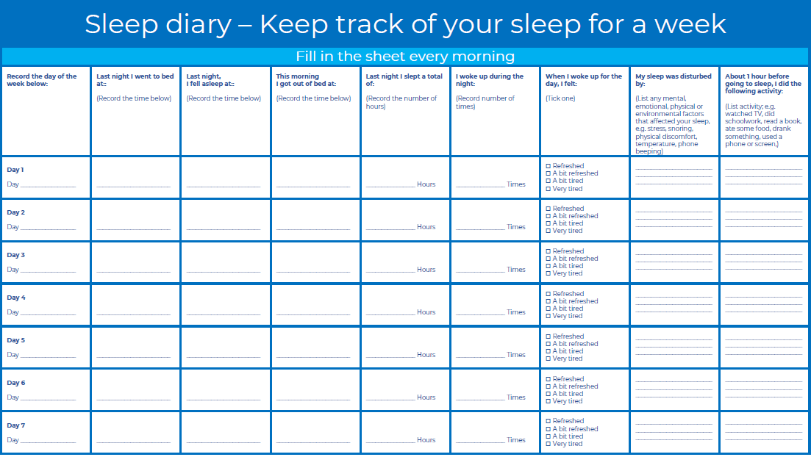
Homework – Sleep diary

Slide 13
Lesson review and 3-2-1 exercise
Learning Goals
3-2-1
At the end of the lesson, I now:
Better understand the science of sleep
Am able to identify some common sleep problems
Better understand my own relationship with sleep.
Am ready to practice personal sleep analysis
Three things I learned today.
Two Things I found interesting?
One question I still have?
Notes:
This slide is the review of learning goals and there is also a 3-2-1 worksheet exercise.
Students are invited to reflect on:
Three things I learned today.
Two things I found interesting.
One question I still have.

