Slide 1
The importance of sleep
Lesson 1
About sleep
Version 1 2023
Notes:
This is the first lesson of a 3-lesson teaching module called The importance of sleep.

Slide 2
Lesson introduction
Learning goals
Wellbeing indicators
By the end of the lesson, we will:
Better understand the importance of sleep.
Better understand the relationship between sleep and wellbeing.
Be able to identify other aspects of our lives that sleep can influence.
Notes:
Outline of the learning goals.

Slide 3
Lesson introduction
The importance of sleep – short video
Notes:
Introductory video for Lesson 1 of the "The Importance of Sleep" teaching module. This short 2’03” video is intended to get the discussion going in the classroom about how important sleep is for our wellbeing. All the information and statistics in the video are from the November 2022 Planet Youth Survey of 4,339 15 and 16 year-old pupils in the 91 post-primary schools and centres in Galway, Mayo and Roscommon. This video was developed with the support of the students and staff in Castlerea Community School. Click on the image to link to the video, which is hosted on the Planet Youth SPHE website called The Facts.

Slide 4
Discussion
So, what do we think, is sleep important?
Why is it important?
Are there more reasons why than the ones mentioned in the video?
Notes:
Teacher led classroom discussion.
What do we think, is sleep important?
Why is it important?
Are there more reasons than those mentioned in the video?

Slide 5
Some reasons why sleep is important
So why is sleep so important?
Learning
Emotional wellbeing
Physical wellbeing
Retaining information
Regulating mood and emotions
Growth
Memory consolidation
Anger and irritation
Builds muscle mass and strength
Problem solving
Ability to cope
Strengthens our immune system
Reasoning
Self confidence and self-esteem
Weight regulation
Recall & creativity
Stress
Promotes healing and cell repair
Notes:
This slide highlights just some of the ways that sleep affects different areas of our lives. (The list is not exhaustive)
Why is sleep so important?
Sleep is a natural behaviour and although we may not be aware of it, it is a very busy time for the brain and the body. Good quality sleep rests and rejuvenates us in preparation for each new day. There are many processes that happen during sleep and each one benefits and promotes our health and wellbeing.
Learning
There are a number of processes that happen during different stages of sleep. These include learning and memory consolidation. New information gained during the day is moved from the short term to the long term memory allowing us to recall the information at a later date. For younger children vocabulary is retained and learning related to pronunciation of words is processed. Sleep is critical for teenagers as during adolescence the prefrontal cortex is fully developing. This is the part of the brain that relates to problem solving, reasoning and regulating our emotions.
Emotional wellbeing
Lack of sleep affects our mood and emotions. Feelings of tiredness can become overwhelming, and we become irritable and angry more easily. We can feel tearful stressed and unable to cope. Problems and worries may increase resulting in behavioural difficulties. There can be low mood, lack of motivation to find solutions, lack of self-confidence, and low self-esteem. The good news is that sleep helps us to manage and improve all these.
Physical wellbeing
Growth hormone is released mainly during the night and peaks during the first period of deep sleep. As the name suggests growth hormone is important for physical growth and development but it has other properties too. It increases muscle mass and strengthens bones. The immune system is also strengthened, and this helps to protect us from becoming poorly. Any healing and cell repair that is needed in the body happens at this time too it also helps to regulate our weight. By sleeping properly and letting these functions occur we are also helping protect our body from conditions in later life such as obesity type 2 diabetes and heart conditions. Research also shows a link between sleep and looking younger, so beauty sleep really does exist.

Slide 6
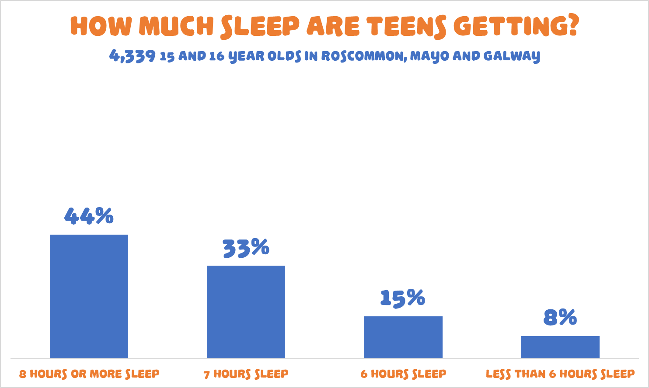
Notes:
So how much sleep are teens really getting? Not enough is the answer, unfortunately. Only 44% are getting anywhere near the correct amount, which is 8-10 hours per night. This chart shows results from the November 2022 Planet Youth survey of 4,339 15 and 16 year olds in all the 91 schools and Youthreach centres in Galway, Mayo and Roscommon.

Slide 7
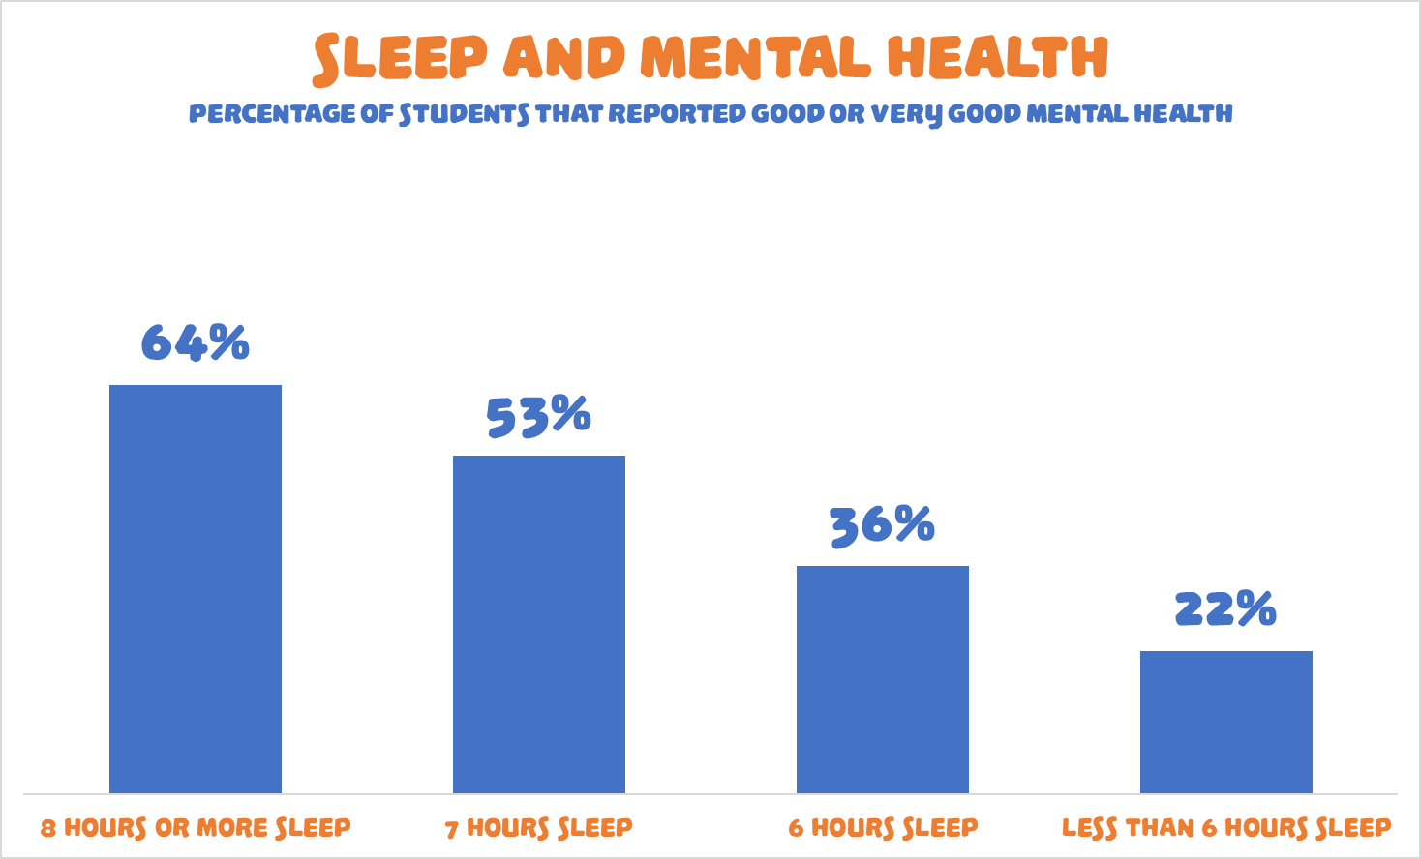
Notes:
Slides 7-13 are intended to convey just how dramatically sleep deprivation affects so many areas of our lives and our wellbeing. They show the relationship between quantity of sleep and: Mental health Physical health Wellbeing Stress Self-esteem School engagement
Schoolwork These slides can be delivered slowly or quickly depending on the time available. Once the first slide has been explained then the rest should be clear. This slide shows the percentage of pupils that self-reported having good or very good mental health, correlated against amount of sleep per night. All statistics are from the November 2022 Planet Youth Survey of 4,339 15 and 16 year-old pupils in the 91 post-primary schools and centres in Galway, Mayo and Roscommon.

Slide 8
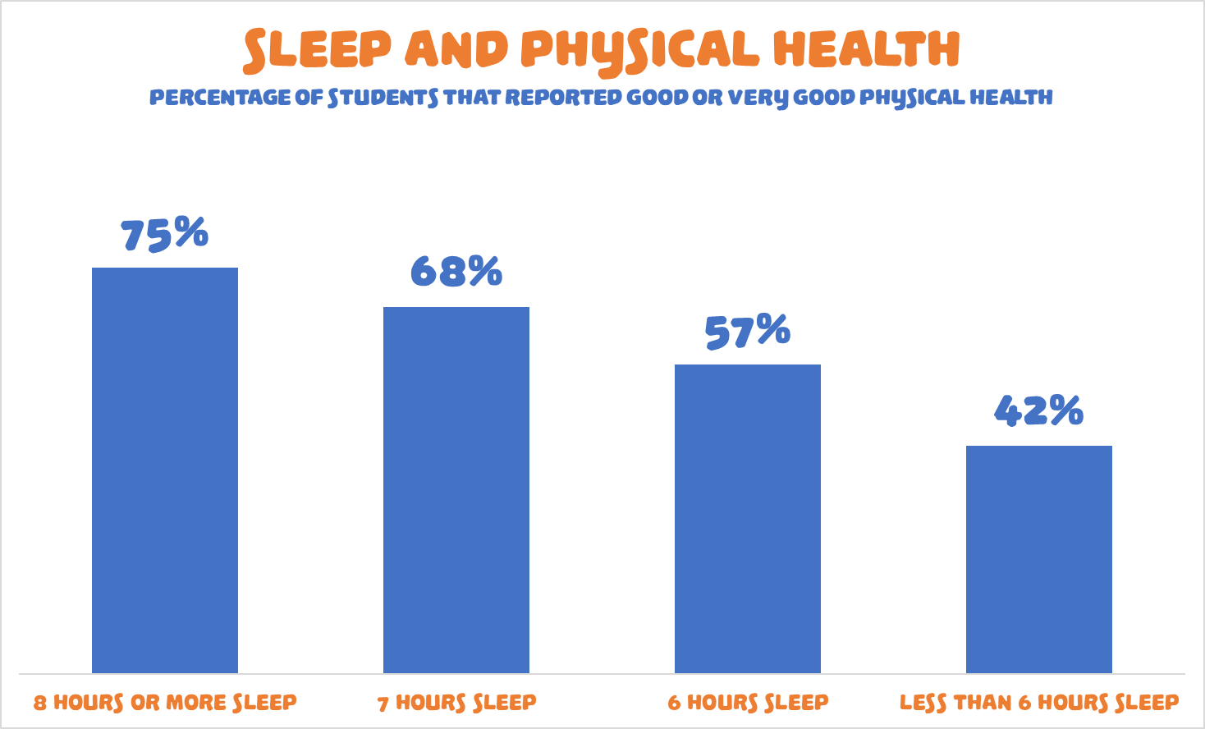
Notes:
This slide shows the percentage of pupils that self-reported having good or very good physical health, correlated against amount of sleep per night. All statistics are from the November 2022 Planet Youth Survey of 4,339 15 and 16 year-old pupils in the 91 post-primary schools and centres in Galway, Mayo and Roscommon.

Slide 9
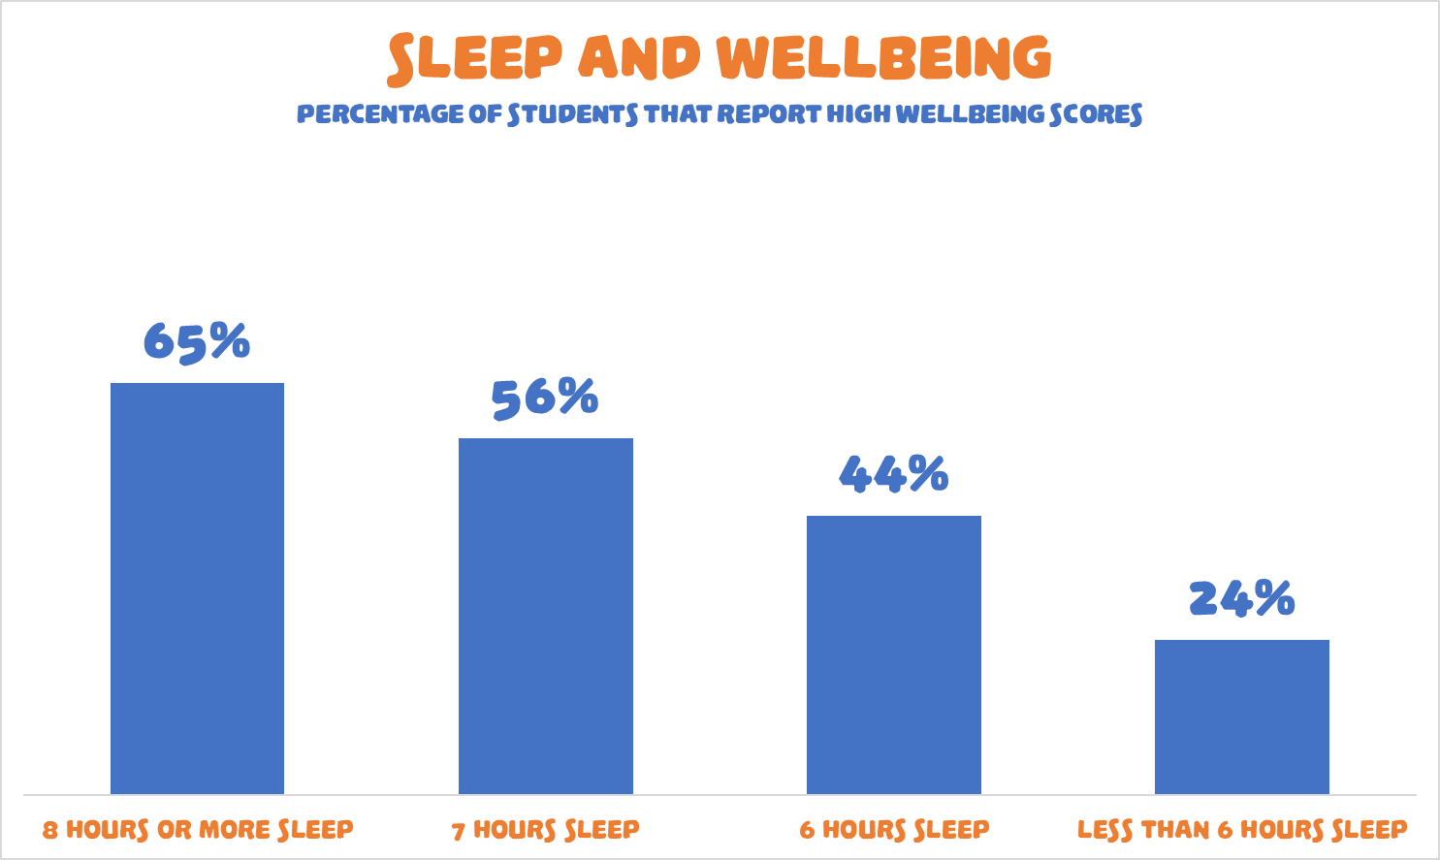
Notes:
This slide shows the percentage of pupils that had high wellbeing scores, correlated against amount of sleep per night. The scores are derived from the Short Warwick-Edinburgh Mental Wellbeing Scale (SWEMWBS). This is a seven-question validated scale.
All statistics are from the November 2022 Planet Youth Survey of 4,339 15 and 16 year-old pupils in the 91 post-primary schools and centres in Galway, Mayo and Roscommon.

Slide 10
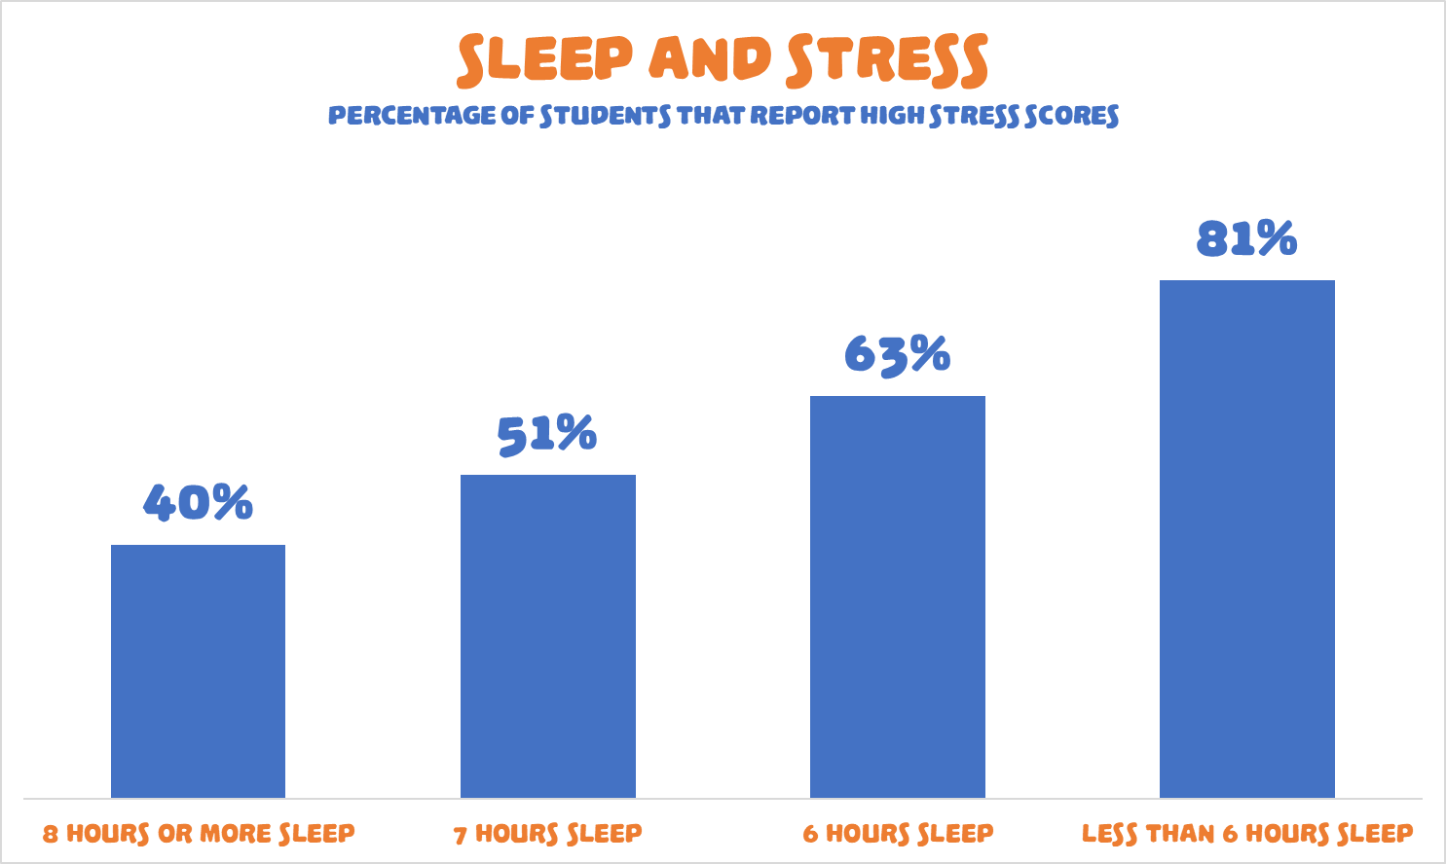
Notes:
This slide shows the percentage of pupils that had high stress scores, correlated against amount of sleep per night. Scores are derived using a ten-question validated scale for measuring stress.
All statistics are from the November 2022 Planet Youth Survey of 4,339 15 and 16 year-old pupils in the 91 post-primary schools and centres in Galway, Mayo and Roscommon.

Slide 11
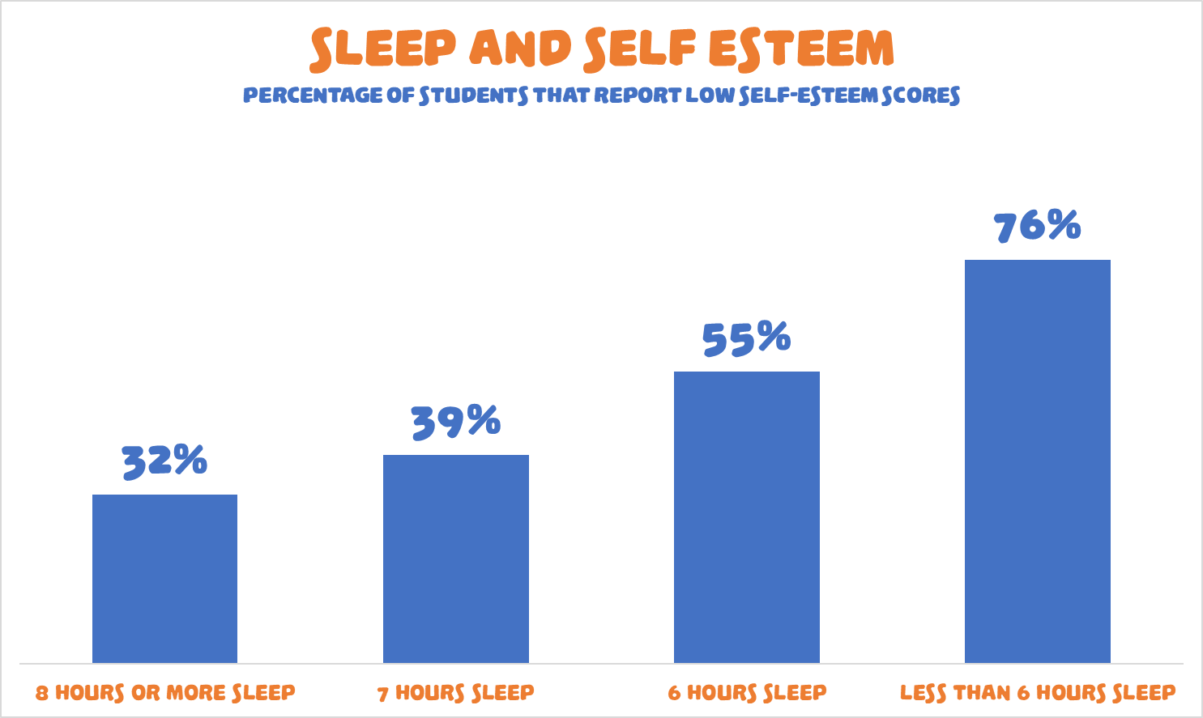
Notes:
This slide shows the percentage of pupils that low self-esteem scores, correlated against amount of sleep per night. The scores are derived from the Rosenberg Self-Esteem ten-question scale.
All statistics are from the November 2022 Planet Youth Survey of 4,339 15 and 16 year-old pupils in the 91 post-primary schools and centres in Galway, Mayo and Roscommon.

Slide 12
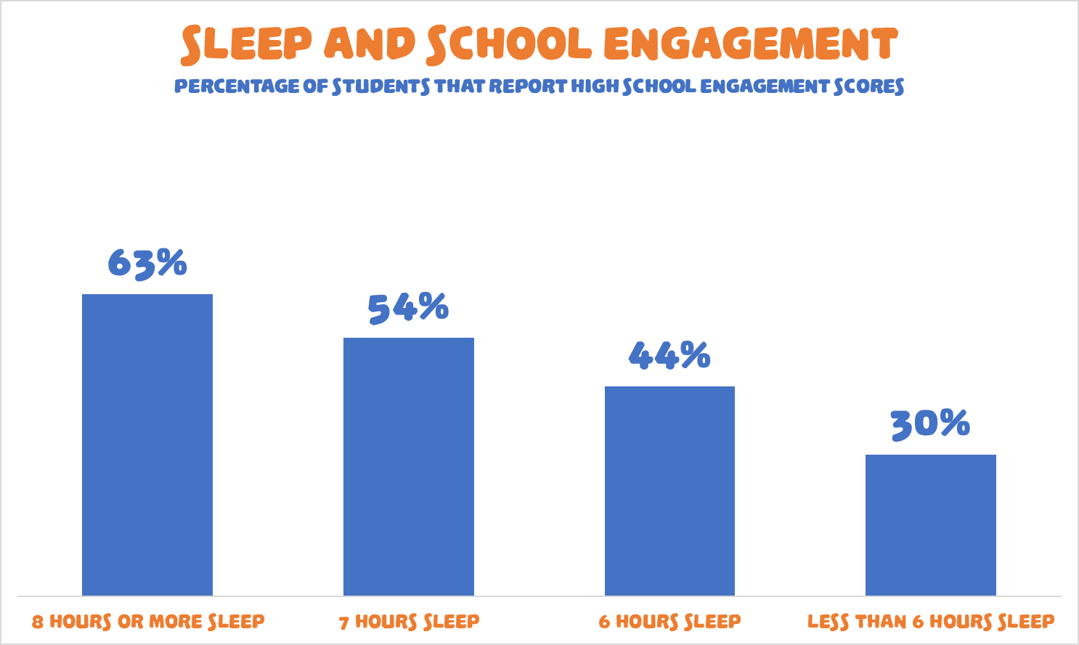
Notes:
This slide shows the percentage of pupils that high school engagement scores, correlated against amount of sleep per night. The scores are derived from a ten-question scale developed by ICSRA.
All statistics are from the November 2022 Planet Youth Survey of 4,339 15 and 16 year-old pupils in the 91 post-primary schools and centres in Galway, Mayo and Roscommon.

Slide 13
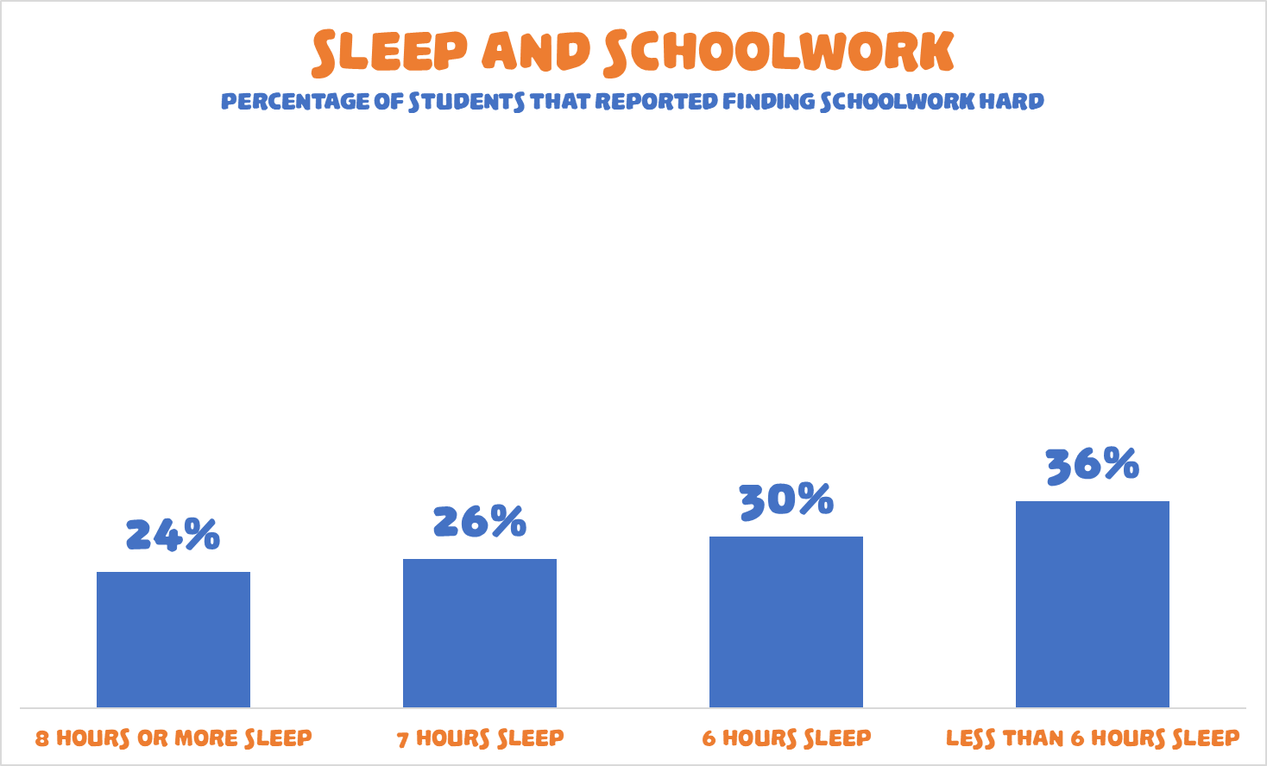
Notes:
This slide shows the percentage of pupils that agreed, or strongly agreed, that they find schoolwork hard, correlated against their amount of sleep per night. This is just one simple question within the string of survey questions about school experience. All statistics are from the November 2022 Planet Youth Survey of 4,339 15 and 16 year-old pupils in the 91 post-primary schools and centres in Galway, Mayo and Roscommon.

Slide 14
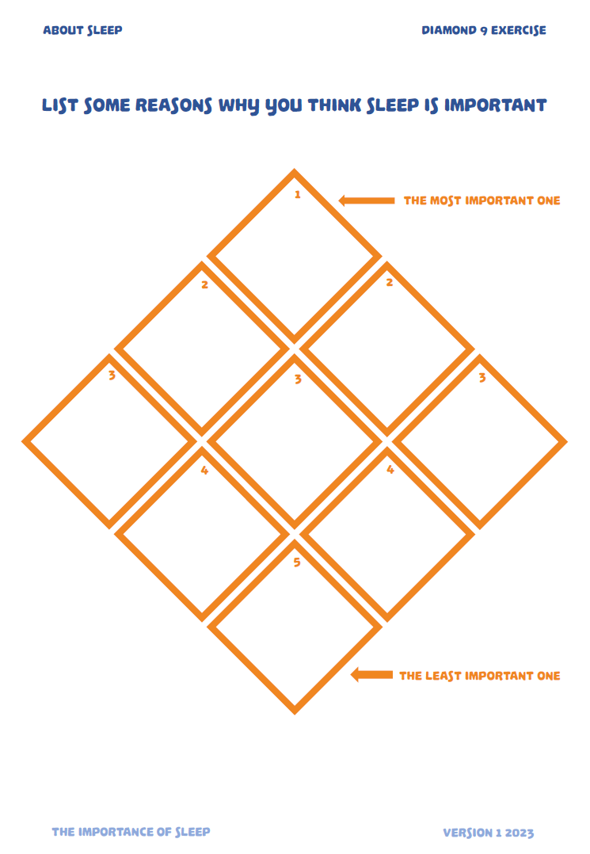
Diamond 9 exercise
Why do you think sleep is important?
List some reasons why you think sleep is important
Try to come up with nine
Put your most important one at the top and your least important at the bottom
Notes:
Diamond 9 class exercise. Can be completed individually or in groups and the exercise can then be discussed. The list on slide 5 and the bar charts are not exhaustive of all the reasons that sleep is important. Students may come up with some additional reasons worthy of discussion.

Slide 15
Lesson review and 3-2-1 exercise
Learning Goals
3-2-1
At the end of the lesson, I now:
Better understand the importance of sleep.
Better understand the relationship between sleep and wellbeing.
Am able to identify other aspects of my life that sleep can influence.
Three things I learned today.
Two Things I found interesting?
One question I still have?
Notes:
This slide is the review of learning goals and there is also a 3-2-1 worksheet exercise.
Students are invited to reflect on:
Three things I learned today.
Two Things I found interesting.
One question I still have.

Slide 16
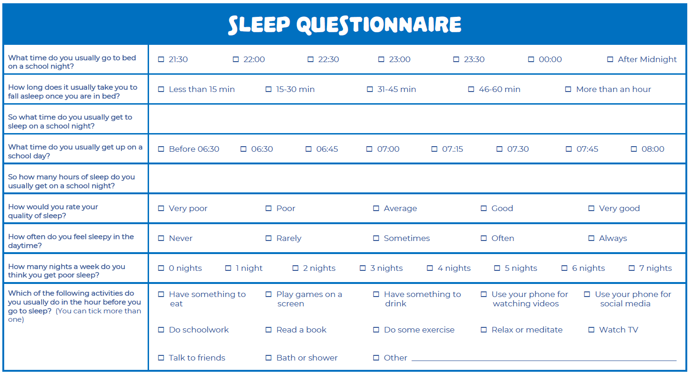
Homework – Sleep questionnaire
Notes:
This is the Sleep Questionnaire worksheet that can be assigned as homework or used at the start of Lesson 2.

